Slide 1


Oral Communication Skills A
(CELEN069)
Lesson 2.1

Slide 2
Lesson aims and objectives
By the end of this lesson, you should have enhanced your speaking and listening ability through practice.
In addition, you should be better able to … | Intended Learning Outcomes
implement strategies for improving pronunciation by yourself | 1.1 1.3 3.3 3.6
identify features of connected speech when listening
use features of connected speech when speaking

Slide 3

Pronunciation
(Autonomous learning)

Slide 4
Pronunciation: Autonomous learning
On the OCSa course, you will be introduced to various features of pronunciation (connected speech, stress, pausing and intonation), but you will need to improve your pronunciation of individual words by yourself as you learn them.
When learning a new word, how can you find out how to pronounce it?
How can you check your pronunciation of individual words?

Slide 5
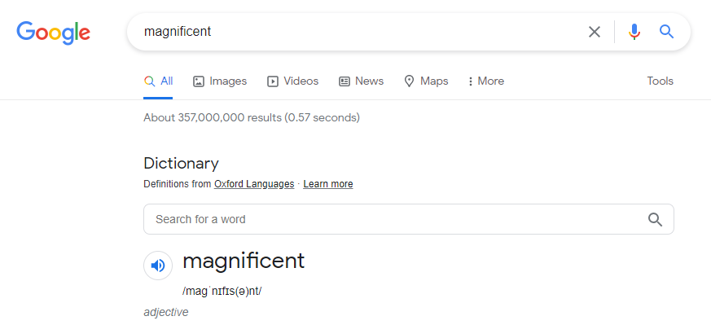
Pronunciation: Autonomous learning
When learning a new word, how can you find out how to pronounce it?
You can use a dictionary to check the pronunciation of a new word.
Open the dictionary app on your phone OR type the word into Google.
Click to listen to the pronunciation.

Slide 6
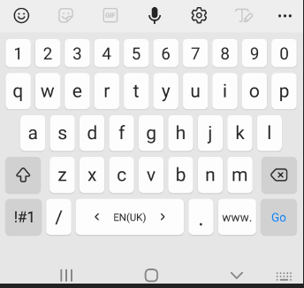
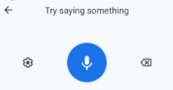
Pronunciation: Autonomous learning
How can you check your pronunciation of individual words?
You can use the voice recognition software on your phone to check your pronunciation.
Click the search box on your dictionary OR the search box in Google.
Instead of typing the word, click on the microphone symbol on your keyboard (make sure the keyboard is set to English language).
Say the word and watch it being transcribed.
If the word that is transcribed is the one that you were trying to say, well done!
If the word that is transcribed is a different one from the one that you were trying to say, listen to the original word again and then try pronouncing it again.

Slide 7
Pronunciation Quiz
(Review)

Slide 8
Pronunciation Quiz: Reflection
The purpose of the Pronunciation Quiz was to raise your awareness of certain pronunciation features. Being aware of these features can help you to improve your listening and your speaking.
In pairs, discuss your performance on the quiz.
How easy/ difficult did you find the quiz?
Which section of the quiz do you feel the most confident about? Which area(s) do you need to improve in?

Slide 9
Pronunciation Quiz: Review of the basics
In today’s lesson we’re going to focus on pronunciation features from Part One of the quiz (i.e. Sounds).
1. How many syllables does the word magnificent have?
2. Which syllable is the stressed one in the word magnificent?
3. Which of these sentences does your teacher read out?
a. The view is magnificent.
b. The view was magnificent.
4. Which of these sentences does your teacher read out?
a. I want something magnificent.
b. I won something magnificent.
In small groups, answer the questions on the right.

Slide 10
Pronunciation for listening
Connected speech

Slide 11




Connected speech: Introduction (1)
When listening to a proficient English speaker, you may notice that they join the sounds of words together. This is known as connected speech. Being aware of some of the rules of connected speech can help you improve your listening.
Listen to the recorded sentences and write them down.
1. Every time I eat vanilla ice cream, I feel happy.
2. Every time I eat something spicy, I scream.

Slide 12



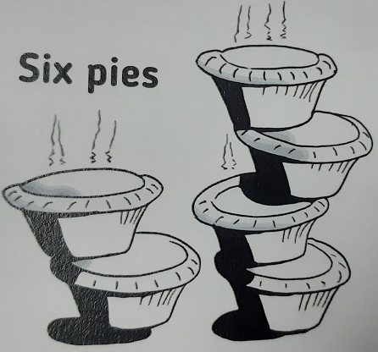
Connected speech: Introduction
Sometimes, phrases which appear completely different may sound the same in connected speech. You will need to use the context to distinguish them.
e.g. ice cream - I scream sick spies - six pies

Slide 13


Connected speech: Introduction (2)
Listen to the recordings and choose the option that you hear.
(1) a. big guys
b. big eyes
(2) a. Someone call Dan!
b. Someone called Anne.
(3) a. I lie quite a lot.
b. I like white a lot.
(4) a. great eyes
b. grey ties
(5) a. It’s old fish.
b. It sold fish.
(6) a. find answers
b. fine dancers

Slide 14
Connected speech
(Consonant to consonant)

Slide 15
Connected speech: Consonant to consonant (1)
Listen to the sentences below pronounced in two different ways. The first is the ‘dictionary’ way and the second is the ‘natural’ (connected speech) way.
Compare how the underlined words are pronounced.
This is relevant to many people.
This is an example of unstructured data.
English is one of the most influential languages.

Slide 16
Connected speech: Consonant to consonant
Missing sounds
When a word ends in a consonant, and the next word starts with the same consonant, the final consonant in the first word may go missing.
e.g. This is relevant to many people.
This is an example of unstructured data.
English is one of the most influential languages.
X
X
X

Slide 17

Connected speech: Consonant to consonant
Suggested answers:
1. innate talent
2. outdated data
3. interactional language
4. widespread damage
5. cognitive value
6. detrimental lifestyle
7. mood disorder
Match the words on the left to the ones on the right to create phrases that contain missing sounds.
X
X
1. innate
2. outdated
3. interactional
4. widespread
5. cognitive
6. detrimental
7. mood
a. value
b. lifestyle
c. talent
d. language
e. data
f. disorder
g. damage
X
X
X
X
X

Slide 18
Connected speech: Consonant to consonant (2)
Read the sentences below and underline the words that contain missing sounds. Then listen to check your predictions.
1. That’s something that students see every day.
2. Today I’m feeling a little bit tired.
3. Jogging and running are the best types of cardio.
4. Staff have to undertake some mandatory training.
5. Transition is the process of changing from one state to another.
6. The aim is to retain new employees.
7. Decay is often caused by inappropriate treatment.

Slide 19
Connected speech: Consonant to consonant
1. That’s something that students see every day.
2. Today I’m feeling a little bit tired.
3. Jogging and running are the best types of cardio.
4. Staff have to undertake some mandatory training.
5. Transition is the process of changing from one state to another.
6. The aim is to retain new employees.
7. Decay is often caused by inappropriate treatment.

Slide 20
Connected speech
(Consonant to vowel)

Slide 21
Connected speech: Consonant to vowel
Read the phrases below slowly and then faster. Is there a difference for the underlined sounds?
in English → I nEnglish
we’ve paid a lot → we’ve pai dalot
as far as I’m concerned → as fa ra sI’m concerned
Moving sounds
When a word ends in a consonant, and the next word starts with a vowel, the final consonant in the first word tends to move to the next word.

Slide 22
Connected speech: Consonant to vowel
Read the phrases below. Can you identify the moving sounds?
(1) … can result in … | (2) … is only …
(3) … this is … | (4) … influence on …
(5) … an example of … | (6) … a combination of …
(7) ... a symptom of … | (8) … lack of …
… can resul tin …
… i sonly …
… thi sis …
… influen ceon …
… a nexamp leof …
… a combinatio nof …
… a sympto mof …
… la ckof …
Listen to the recording to check your answers.

Slide 23
Connected speech: Consonant to vowel
Memory Game
Work in groups of 3-4.
Student 1: Use one of the phrases on the right to make a short sentence and tick the phrase to show you’ve used it.
e.g. This is easy to understand.
Student 2: Repeat the sentence said by S1 and then make a sentence with one of the other phrases. Tick.
Student 3: Repeat the sentences said by S1 and S2 and then make a sentence with one of the other phrases. Tick.
Continue until you’ve used all the phrases.
Who has the best memory?
 | Used
… can resul tin …
… thi sis …
… a nexamp leof …
… a sympto mof …
… i sonly …
… influen ceon …
… a combinatio nof …
… la ckof …
Notes:
This can result in language change.
This is an example of English slang.
Lack of confidence in using new vocabulary is normal.
This situation is only temporary.
Active students get better results than passive students.
A combination of factors influence one’s personality.
Peers can have an influence on one’s reading habits.
Headaches can be a symptom of stress.

Slide 24
Connected speech
(Vowel to vowel)

Slide 25

Connected speech: Vowel to vowel (1)
Read the phrases below slowly and then faster. Notice how the dark coloured consonants link to the next word.
day and night → da yand night
new and old → ne wand old
war and peace → wa rand peace
Now read these phrases, first slowly and then faster. Can you hear the /y/ - /w/ - /r/ sounds anywhere?
tea and coffee → tea (y)and coffee
tomato and onion → tomato (w)and onion
pasta and sauce → pasta (r)and sauce
Please note that some pronunciation may vary depending on the speaker’s accent.

Slide 26
Connected speech: Vowel to vowel
Linking sounds
When a word ends in a vowel and the next word starts with a vowel, one of the sounds below is usually inserted between the two vowels to avoid them blending into each other.
(y) → e.g. me (y)and you
(w) → e.g. you (w)and me
(r) → e.g. the idea (r)of
Please note that some pronunciation may vary depending on the speaker’s accent.

Slide 27
Connected speech: Vowel to vowel (2)
START
Work in groups. Your objective is to get from START to FINISH, moving from cell to cell according to the pronunciation of the phrase in each cell.
You can only move according to the linking sounds. The first step has been done as an example.
you and me | me and you | happy or sad | high and low
he is | here and there | pasta or rice | how and why
you are | now or never | go and see | four or five
law and order | tea or coffee | true or false
(w)
(w)
(r)
(r)
(y)
(y)
(y)
(r)
(w)
(r)
(y)
(y)
(w)
(w)
(w)
(r)
(y)
(r)
(w)
(w)
(r)
(w)
(y)
(r)
FINISH
Notes:
This can result in language change.
This is an example of English slang.
Lack of confidence in using new vocabulary is only temporary.
Active students get better results than passive students.
A combination of factors influence one’s personality.
Peers can have an influence on one’s reading habits.
Headaches can be a symptom of stress.

Slide 28
Practice

Slide 29



Pronunciation: Practice
student
tutor
student
student
tutor
tutor
Conversation 1
Conversation 2
Conversation 3
Choose one of the situations above and write down a script for a conversation between the two people.
Use at least two phrases from each column on the next slide.
Practise reading out the conversation focusing on using appropriate connected speech.
When you’re ready, act out the conversation to another pair of students.

Slide 30
Pronunciation: Practice
Connected speech
Consonant to consonant | Consonant to vowel | Vowel to vowel
1. innate talent 2. outdated data 3. interactional language 4. widespread damage 5. cognitive value 6. detrimental lifestyle 7. mood disorder | 1. … can result in … 2. … is only … 3. … this is … 4. … influence on … 5. … an example of … 6. … a combination of … 7. … a symptom of … 8. … lack of … | 1. you and me 2. me and you 3. here and there 4. he is 5. you are 6. now or never 7. tea or coffee 8. true or false 9. go and see 10. pasta or rice 11. how and why 12. four or five
Write down a script for a conversation between the two people on your chosen situation (from the previous slide).
Use at least two phrases from each column.
Practise reading out the conversation focusing on using appropriate connected speech.
When you’re ready, act out the conversation to another pair of students.

Slide 31
Self-study materials

Slide 32
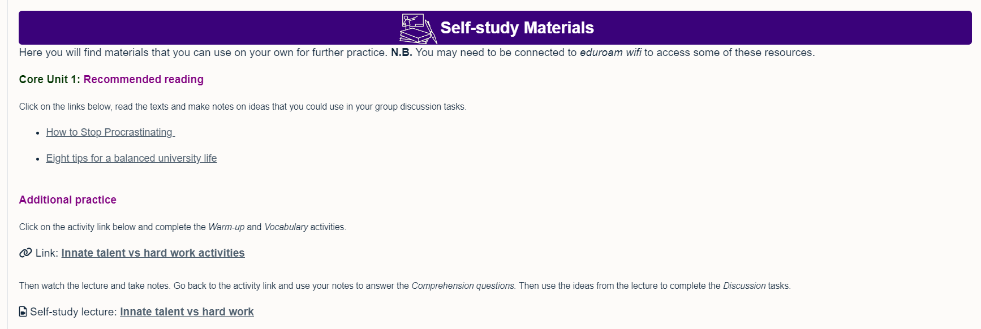
Self-study materials on Moodle
From Week 3, there are interactive self-study materials available for you to use. These are linked to the six Core Units. We strongly encourage you to use these resources.
Further reading on the topic
Lecture listening-based interactive materials

Slide 33

Homework
Due | Task
Lesson 3.1 | Interview someone who is not in your class. Ask them the question below. The person should answer in English for 1-1.5 minutes. Audio/video record their answer and post it on the class Team. What are the 3 biggest differences between high school and university? Complete ‘Vocabulary building’ tasks A & B (Class Workbook - Lesson 3.1).
Note: Bring headphones to Lesson 3.1
REMINDER:
Your next OCSa lesson will be a Live Lecture, so do not come to this classroom.
Instead, go to DH Lawrence Auditorium.

